Slide 2
Objectives
Understand what is meant by and the purpose of media access control (MAC) address
Understand the structure of a MAC address
Understand that there are different types of IP address
Know the characteristics and differences between IPv4 and IPv6
Understand that IP address allocation may be static or dynamic

Slide 3


Starter
Houses have addresses and locations
When trying to find a house, what are at least two ways of identifying its location or address?

Slide 4
Starter
When trying to find a house, what are at least two ways of identifying its location or address?
Postal address – house number and postcode
GPS coordinates
What3Words location
Street directions
Notice that each of these different methods all find the same house, but they all have different reasons why they are used

Slide 5
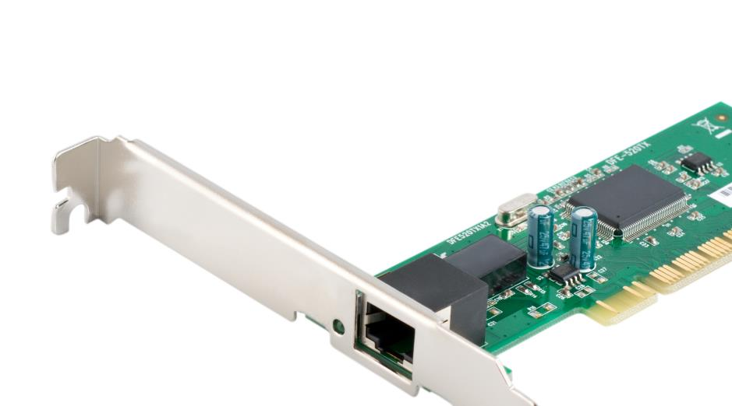
MAC addresses
Each network interface card needs its own Media Access Control Address (MAC address)
The MAC address is given to the NIC when it is manufactured
Every network hardware device has a unique MAC address
MAC addresses are used to send data between two items of hardware on a network – such as a computer and router
MAC address permanently stored on network interface card

Slide 6
MAC addresses
MAC addresses are 48-bit addresses allowing for 281 trillion (2⁴⁸) possible devices
MAC addresses are used on Ethernet, Wi-Fi and Bluetooth devices
MAC addresses are usually written as hexadecimal digits that often have each byte separated by colons or hyphens
An example of a MAC address is:
What do you think the MAC address identifies, other than the specific device it is stored on?
1f-38-69-ba-9f-0c

Slide 7
MAC addresses
The first three bytes (24 bits) of the MAC address contains a number that represents the manufacturer
The second part of the number is the serial code which is given to the hardware device by the manufacturer
1f-38-69-ba-9f-0c
Manufacturer code
Serial code

Slide 8
Worksheet 2
Complete Task 1, Task 2 and Task 3 on Worksheet 2

Slide 9
Internet Protocol issues
IP version 4 (IPv4) addresses are made from four bytes
They are usually represented as four denary numbers separated by full stops such as:
What is the total number of unique IP addresses that are available?
What is the problem with using 32-bit IP addresses?
192.168.52.211

Slide 10
Internet Protocol issues
Number of 32-bit IP addresses available
= 2³² ≈ 4.3 billion addresses
The problem with 32-bit IP addresses is that there aren’t enough of them
As more and more devices are added to the Internet we need an IP address system that can address all of them
We therefore need to use a larger binary number than a 16-bit address

Slide 11

IPv6
IPv6 (version 6) makes use of 128-bit numbers allowing for a staggering number of devices to be addressed
2¹²⁸ ≈ 340 trillion trillion trillion addresses
This is more than the number of grains of sand in the world
IPv6 addresses are separated into eight groups each containing four hex digits and separated by a colon – for example:
0123 : 4567 : 90ab : cdef : 0123 : 4567 : 89ab : cdef

Slide 12
Writing IPv6 addresses
As IP addresses are so long, there are a number of ways in which they should be written and shortened
Rule | Example | Correct way to write
Hex digits should be in lowercase | 58B3:DC97 | 58b3:dc97
Leading zeros don’t need to be written for each set of four hex digits, but keep one digit if they are all zeros | 10bc:00b3:0000 | 10bc:b3:0
The longest set of zeros, that is more than four hex digits, is replaced with :: (Except if it a single field of zeros) | 10bc:b3:0:0:0:0:0:1a7 | 10bc:b3::1a7

Slide 13
IPv4 and IPv6
You need to be aware of the characteristics and differences of IPv4 and IPv6
 | IPv4 | IPv6
Address size | 32-bit | 128-bit
Number of unique addresses | 4.3 billion | 340 trillion trillion trillion
Separators | Full stops . | Colons :
Security |  | Improved security
Assignment of IP address | DHCP server | IPv6 devices can configure themselves automatically (Autoconfiguration) or use DHCPv6

Slide 14
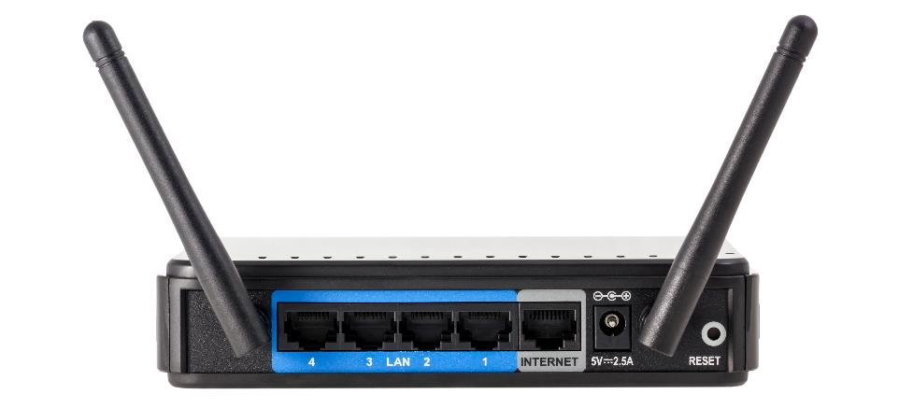
Dynamic IP addresses
When a home router (modem) connects to an Internet Service Provider (ISP) it is allocated an IP address
Sometimes the ISP will give a different IP address each time the router connects – this is known as a dynamic IP address
If the IP address is always the same, it is known as a static IP address

Slide 15
Worksheet 2
Complete Task 4 and Task 5 on Worksheet 2

Slide 16
Plenary
In pairs, explain each of the following terms:
MAC address
IP address
IPv4
IPv6
Dynamic IP address
Static IP address
Manufacturer code
Serial code

Slide 17
Plenary
MAC address – Unique identifier for each hardware device permanently put on the device by the manufacturer
IP address – Unique address for each device used to route packets of data
IPv4 and IPv6 – Standards for IP addresses, IPv4 uses 32-bit addresses whilst IPv6 uses 128-bit addresses
Dynamic and static IP addresses – IP addresses are allocated by the network/ISP and will be the same (static) each time the connection is made, or change (dynamic) each time
Manufacturer and serial code – The first three bytes of the MAC address identifies the manufacturer of the device, whilst the last three bytes identifies the particular device with the serial code

